Slide 1
Artificial Intelligence Methods (AE2AIM)
Lec. 09: Hyper-heuristics
Dr. Xinan Chen (Room PMB442)
School of Computer Science
The University of Nottingham Ningbo, China
Email: xinan.chen@nottingham.edu.cn

Slide 2
In the previous lecture
Ant Colony Optimisation (ACO)
Particle Swarm Optimisation (PSO)

Slide 3
In this lecture
Hyper-heuristics
Motivations of hyper-heuristics
Selection hyper-heuristics
Generation hyper-heuristics
Recent advances

Slide 4
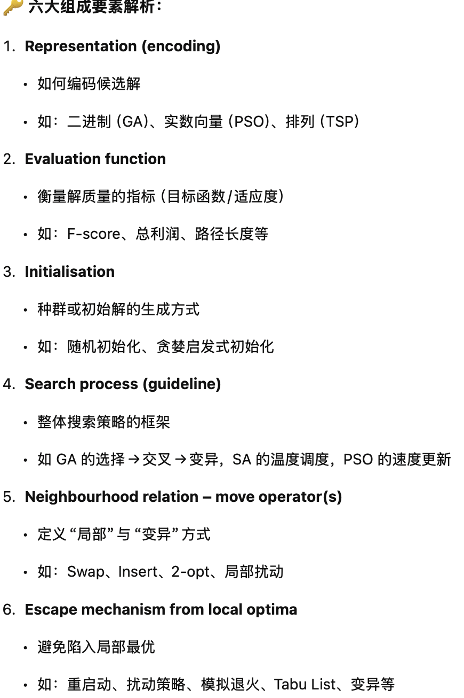
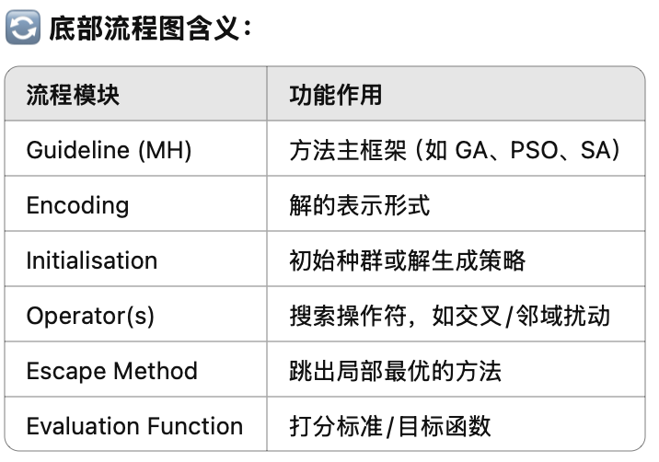
Main Components of Metaheuristics = revisited
Representation (encoding) of candidate solutions
Evaluation function
Initialisation
Search process (guideline)
Neighbourhood relation – move operator(s)
Mechanism for escaping from local optima
Guideline (MH)
Encoding
Initialisation
Operator(s)
Escape
Method
Evaluation
Function

Slide 5
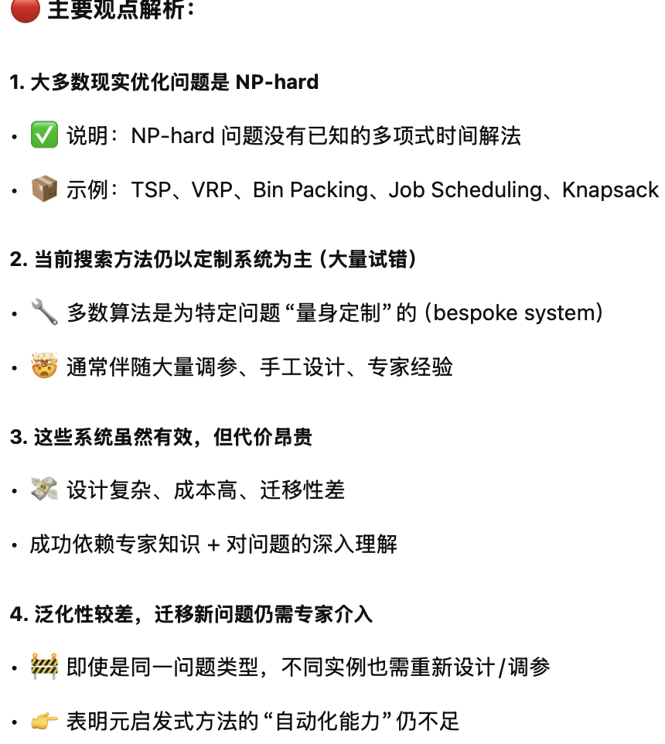
Observations
Most of the real-world optimisation problems are proven to be NP-hard
The current state of the art in search methodologies tend to focus on bespoke systems (mostly trial and error)
In general, these systems are expensive to build, but provide successful results
Unfortunately, their application to new problem domains or even new problem instances from a known domain still requires expert involvement.

Slide 6
Can we do better?
Can we:
raise the generality of the algorithms?
avoid or reduce parameter tuning?
automate the design of heuristics?

Slide 7
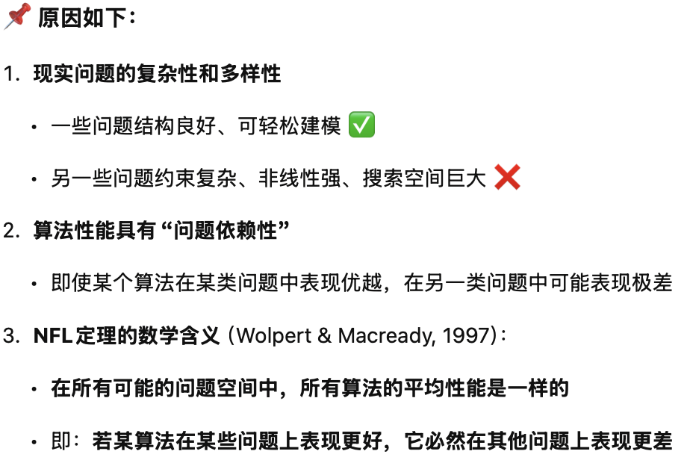
No free lunch theorem
There are so many algorithms for optimization, so what is the best one?
Answer: NO
Reasons that we cannot answer this question
Complexity and diversity of real-world problems often mean that some problem are easier to solve,
whereas, others can be extremely difficult to solve
A single method that can cope with all type of problems is impossible.

Slide 8
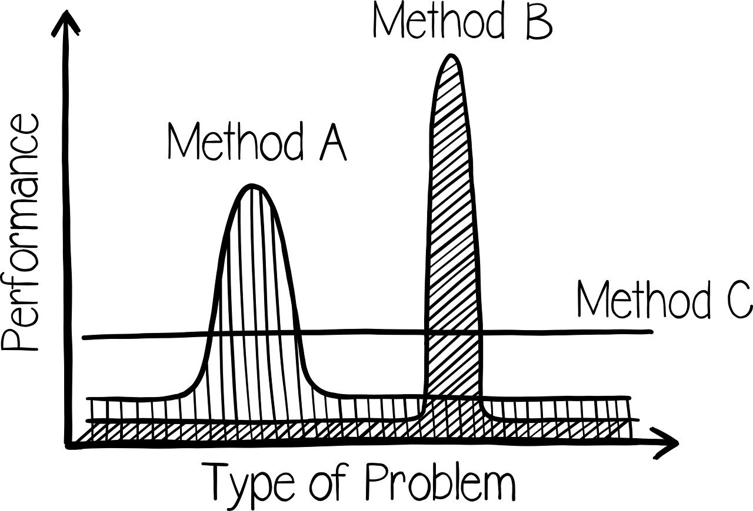
No free lunch theorem
No-free-lunch(NFL) theorem
There’s no one model that works for every problem (scenario)
Assumptions of a great model for one problem may not hold for another problem

Slide 9
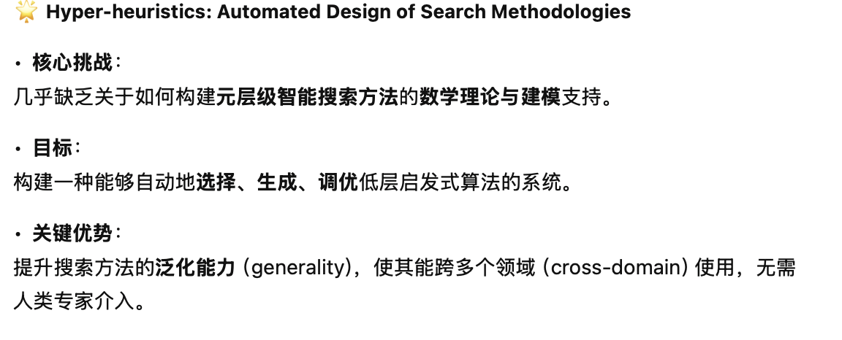
Hyper-heuristics: Automated design of search methodologies
Extremely challenging
Addressed in almost complete absence of a mathematical and theoretical understanding of how to build meta-level intelligent search methodologies which are capable of automatically tuning/selecting/generating systems.
A goal is raising the level of generality of search methodologies through learning and adaptation so that they would be applicable across a broad range of problems without requiring any human expert intervention (cross-domain search).

Slide 10
Hyper-heuristics: Automated design of search methodologies
Motivated by raising the level of generality. What are the limits?
Grand Challenge
Bespoke methods
The General Solver
Significant scope for future research
A
B
C
Doesn’t exist….
Problem Specific Solvers

Slide 11
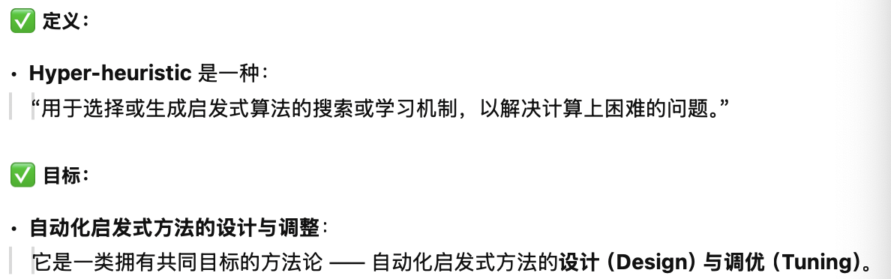
Hyper-heuristics
A hyper-heuristic is a search method or learning mechanism for selecting or generating heuristics to solve computationally difficult problems
A class of methodologies with the common goal of automating the design and tuning of heuristic methods
E. K. Burke, M. Gendreau, M. Hyde, G. Kendall, G. Ochoa, E. Özcan, R. Qu, Hyper-heuristics: A Survey of the State of the Art, Journal of the Operational Research Society, 64 (12) , pp. 1695-1724, 2013. [PDF]

Slide 12
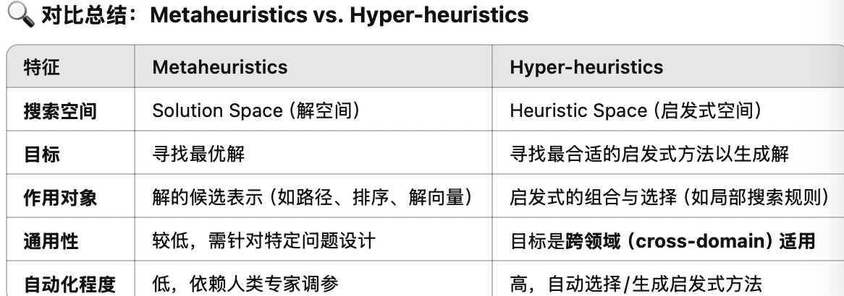
Hyper-heuristics vs. Metaheuristics Different Search Spaces
Metaheuristics
Operate on the solution space
Hyper-heuristics
Operate on the heuristic space
Heuristic Space
Solution Space
Solution Space

Slide 13
Why Hyper-heuristics?
Heuristic search space is a more general search problem
The # of heuristics is often small (<10)
Heuristics can incorporate knowledge (e.g. rules, correlations).
A domain barrier can be added
Increased generality
Heuristic Space
Domain Barrier / Interface
Solution Space
1.更高层次的搜索空间：
2.启发式数量较少：
3.知识集成能力：
4.领域屏障（Domain Barrier）机制：

Slide 14
Classification of Hyper-heuristics
E. K. Burke, M. Hyde, G. Kendall, G. Ochoa, E. Özcan, and J. Woodward (2010). A Classification of Hyper-heuristic Approaches. In Gendreau, Michel and Potvin, Jean-Yves (eds.), Handbook of Metaheuristics, International Series in Operations Research & Management Science, Volume 146, pp. 449-468. Springer.
Heuristic Space
Nature of the heuristic search space
Heuristic selection
constructive heuristics
Solution Space
Hyper-heuristics
Methodologies to select
Fixed heuristics (mostly human designed)
perturbative heuristics
Heuristic generation
constructive heuristics
Automatically generated heuristics from components
Methodologies to generate
perturbative heuristics

Slide 15
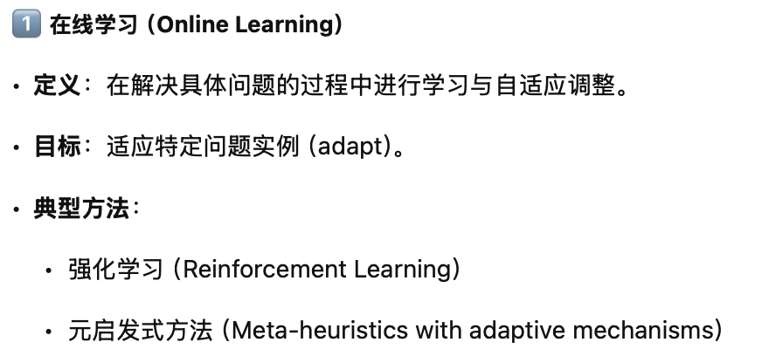
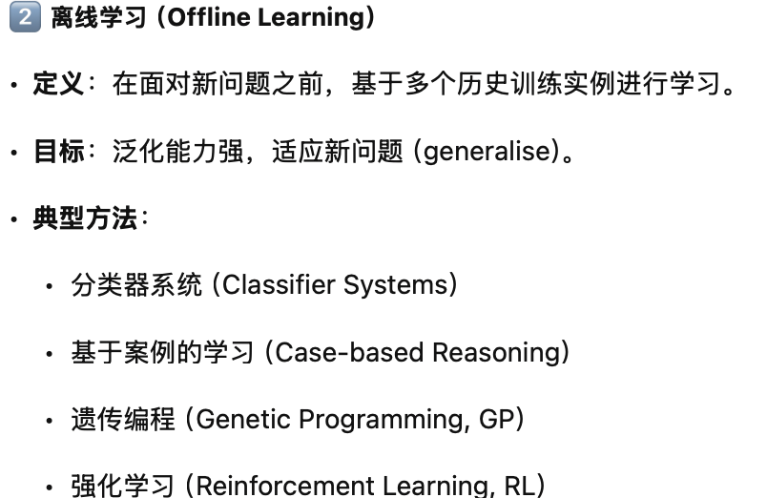

Classification of Hyper-heuristics
Feedback
Online learning
while solving a problem instance (adapt)
Examples: reinforcement learning, meta-heuristics
Offline learning
from a set of training instances (generalise)
Examples: classifier systems, case-based, GP， RL
Online learning
Hyper-heuristics
Offline learning
No- learning

Slide 16
A Hyper-heuristic Framework
Hyper-heuristic
Apply the selected heuristic
Acceptance
Heuristic Selection
SA Criterion
For example:
No. of heuristics
The changes in evaluation function
A new solution or not
The distance between two solutions
Whether it gets stuck or not
Others…
Feedback
Collecting domain-independent information
Domain Barrier
Heuristic Repository
Problem representation
Evaluation Function
Initial Solution
Others…
H₁
H_{n}
H₂
…
2-February-07
Problem Domain

Slide 17
Selection Hyper-heuristics
generate initial candidate solution p
while (termination criteria not satisfied){
select a heuristic (or subset of
heuristics) h from {H₁, ..., H_{n}}
generate a new solution (or solutions) s
by applying h to p
decide whether to accept s or not
if (s is accepted) then
p=s }
return p;

Slide 18
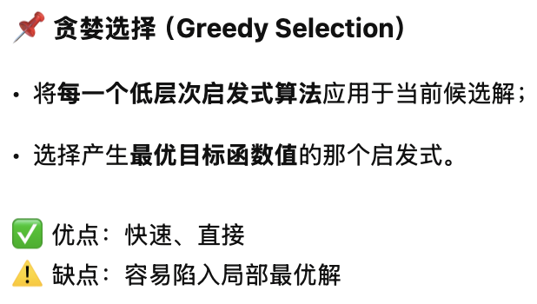
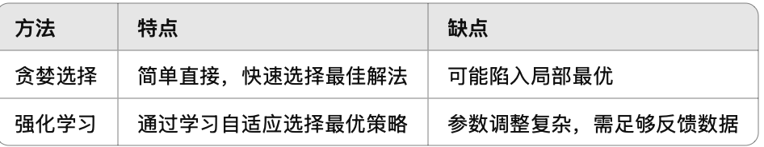
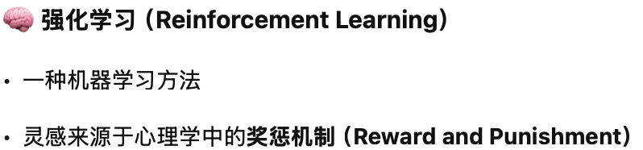
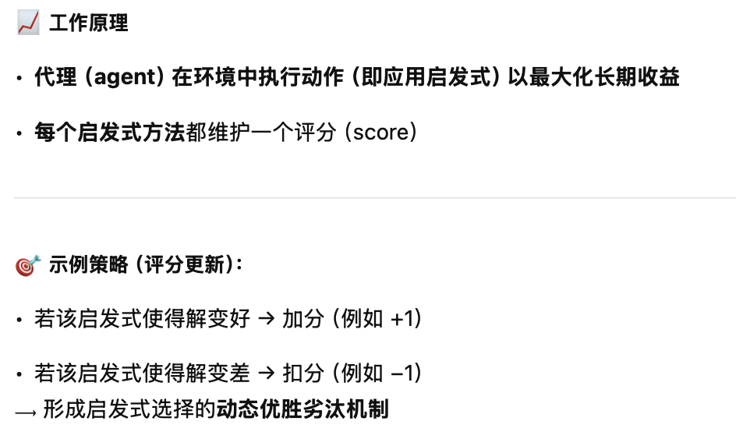
Heuristic Selection
Greedy Selection:
Apply each low level heuristic to the candidate solution and choose the one that generates the best objective value
Reinforcement learning:
A machine learning technique
Inspired by related psychological theory
Reward and punishment
Concerned with how an agent ought to take actions in an environment to maximize some notion of long-term reward
Maintains a score for each heuristic
If an improving move then increase (e.g., +1), otherwise decrease (e.g., -1) the score of the heuristic

Slide 19
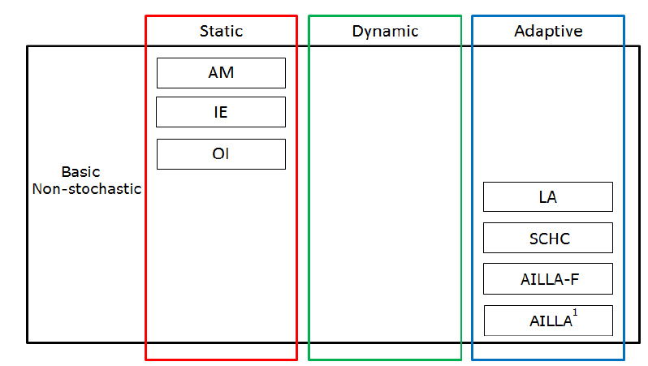
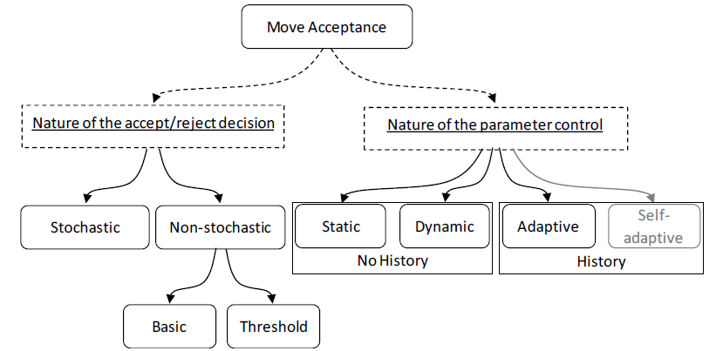
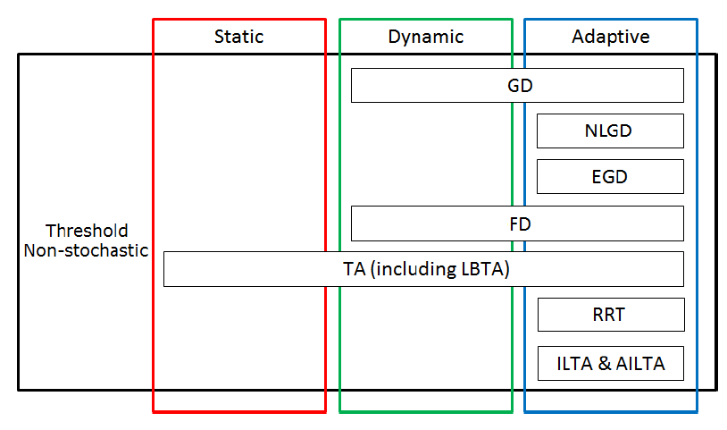
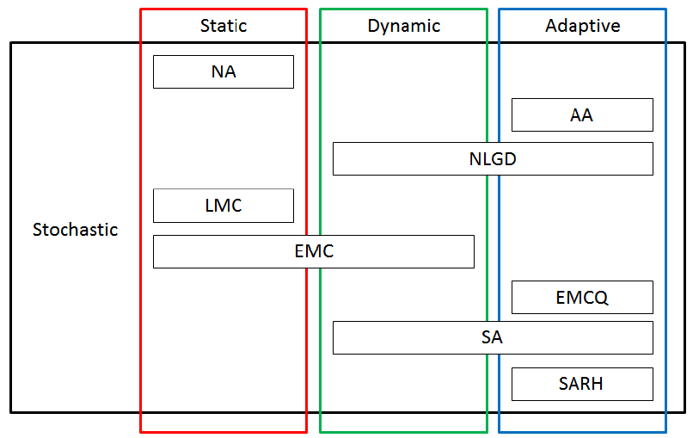
Move acceptance
All Moves
Cowling et al (2000, 2002b)
Only Improving
Improving&Equal
Özcan et al (2009); Jackson et al. (2013)
Late Acceptance
Mısır et al (2012)
Great Deluge
Kendall and Mohamad (2004b) || Bilgin et al. (2006)
Kheiri and Özcan (2015)
Threshold Acceptance
Kendall and Mohamad (2004b)
Record-to-Record
Mısır et al (2009)
Naïve Accept.
Burke et al (2010); Kheiri and Özcan (2012); Asta and Özcan (2015)
Ayob and Kendall (2003)
Exponential Monte Carlo (EMC)
Bai and Kendall (2005); Bilgin et al (2006); Pisinger and Ropke (2007); Antunes et al (2009)
Simulated Annealing (SA)
Dowsland et al (2007); Bai et al. (2007a)

Slide 20
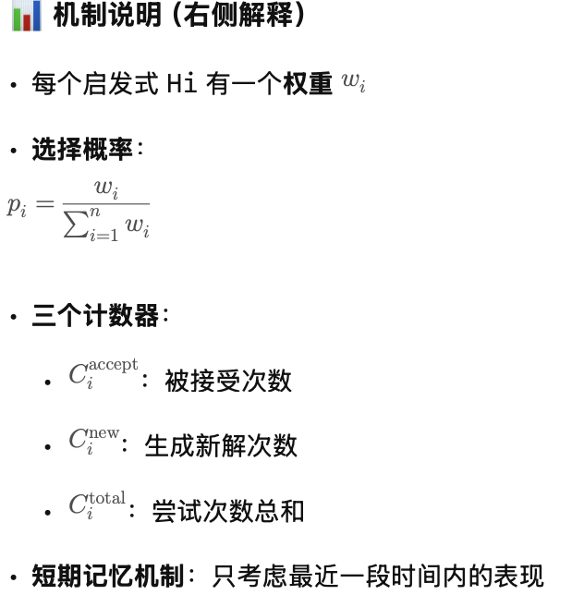
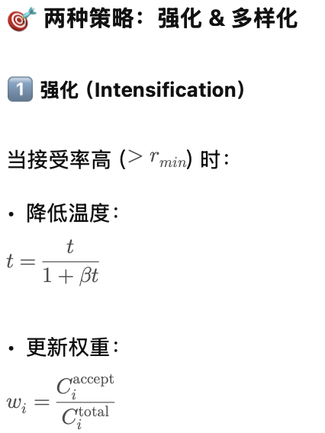
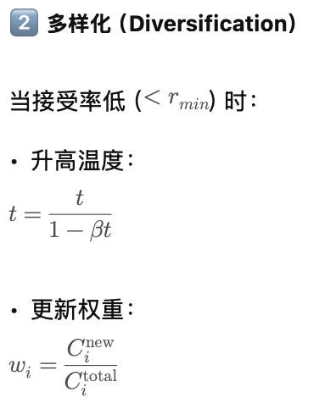
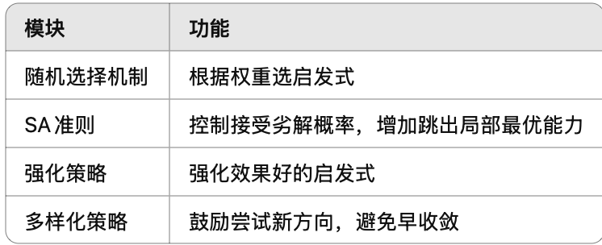
Simulated Annealing Hyper-heuristic
Simulated Annealing Hyper-heuristic
Each heuristic is associated with a weight w_{i}
Selection probability
Three counters: C_{i}^{accept}, C_{i}^{new}, C_{i}^{total}
Short-term memory
Intensification: if (Acceptance ratio > r_{min})
t=t/(1+βt), w_{i}= C_{i}^{accept}/C_{i}^{total}
Diversification: if (Acceptance ratio < r_{min})
t=t/(1-βt), w_{i}= C_{i}^{new}/C_{i}^{total}
Apply the selected heuristic
SA
Criterion
Stochastic Heuristic Selection Mechanism
SA Criterion
Feedback
Collecting domain-independent information
Domain Barrier
Heuristic Repository
Problem representation
Evaluation Function
Initial Solution
Others…
H₁
H_{n}
H₂
…
2-February-07
Problem Domain

Slide 21
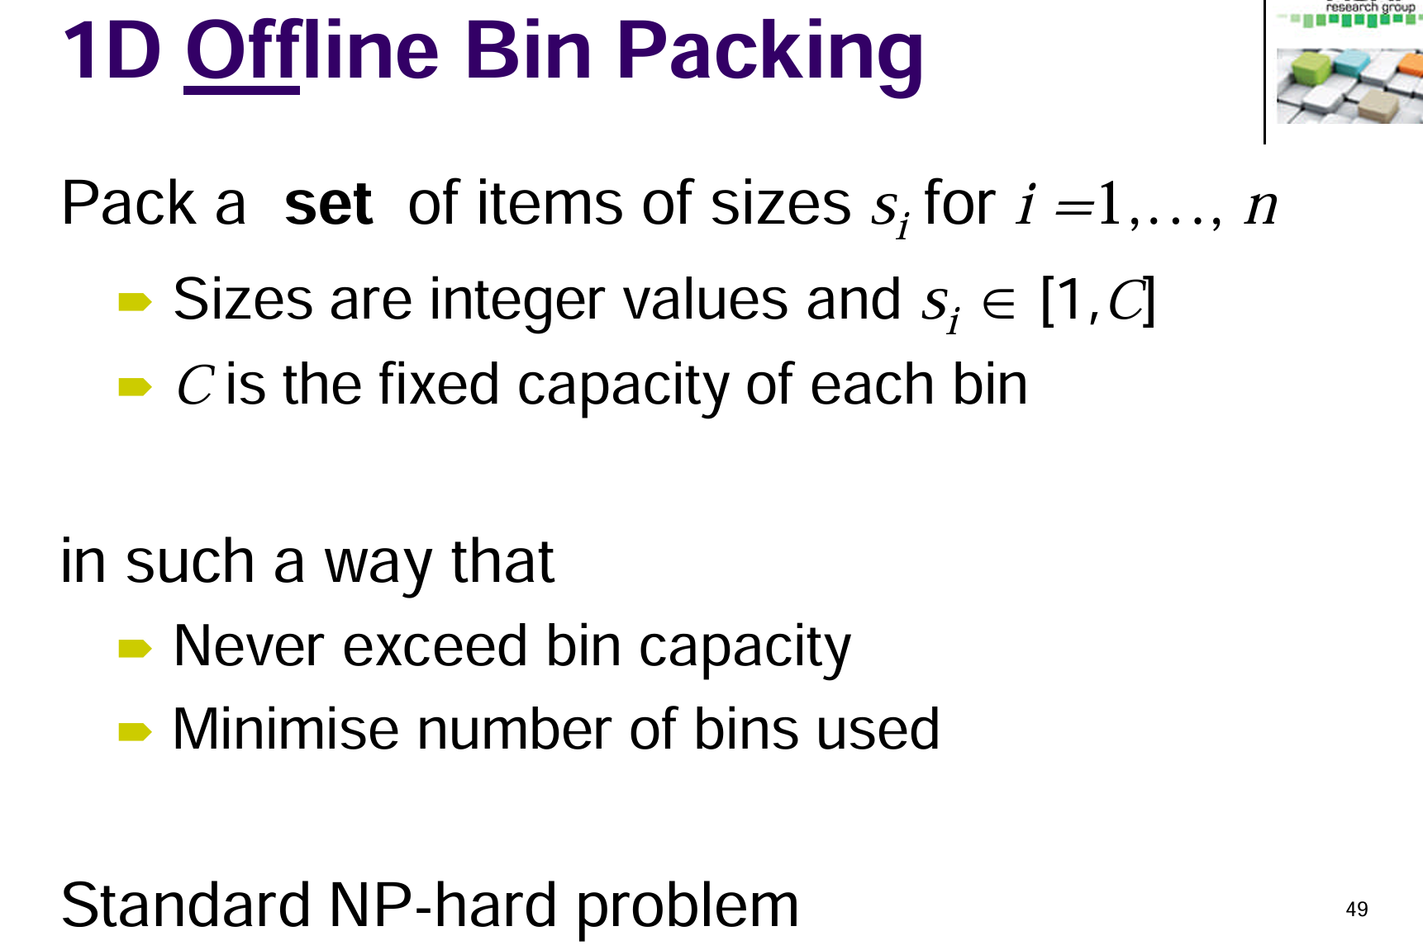

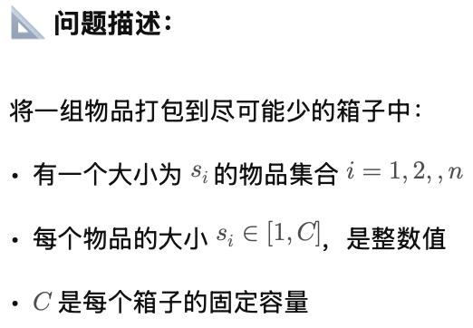
Case Study: GP Hyper-heuristic

Slide 22
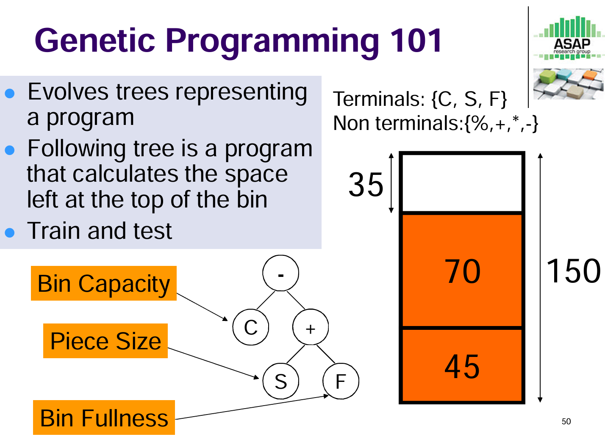
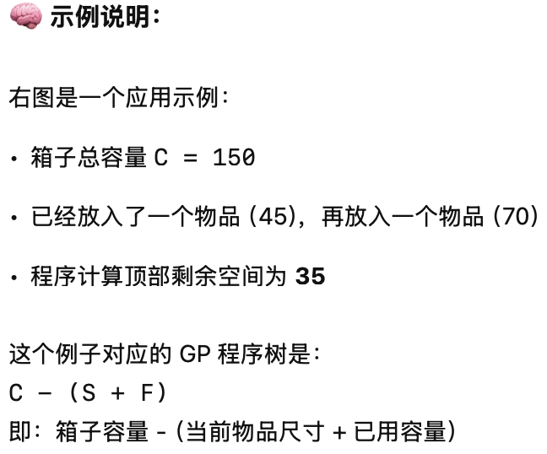
Case Study: GP Hyper-heuristic

Slide 23
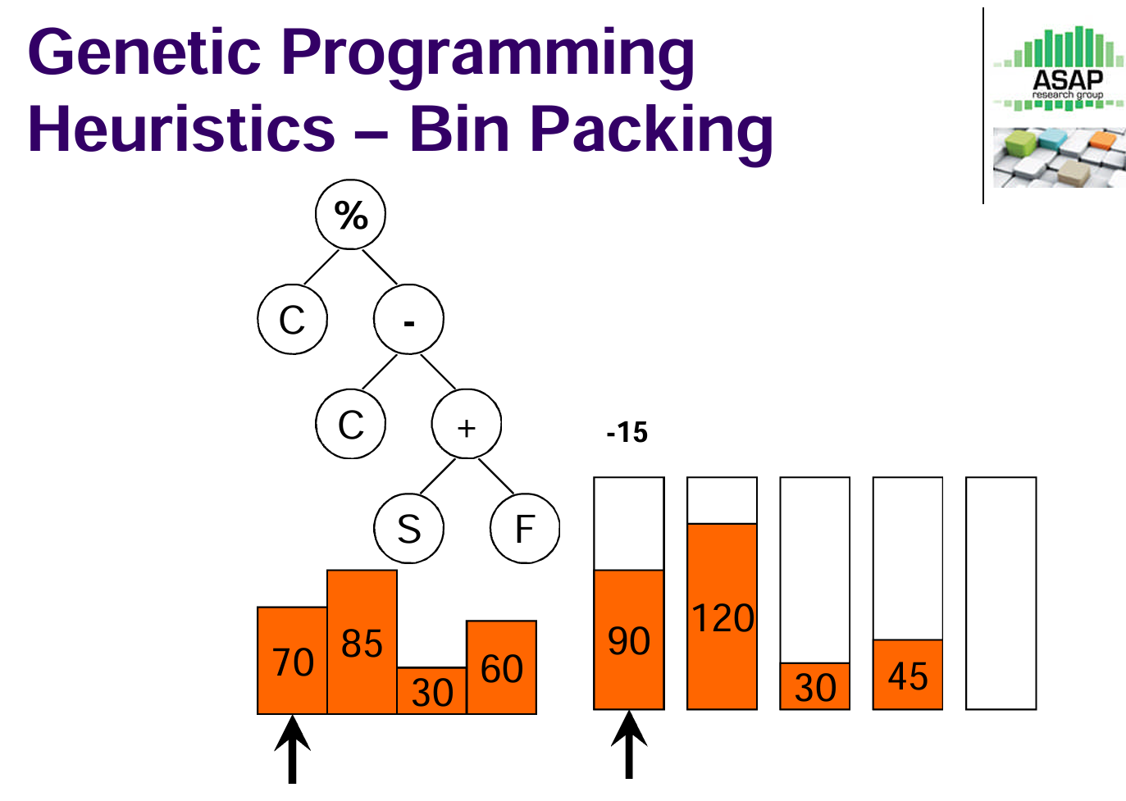
Case Study: GP Hyper-heuristic

Slide 24
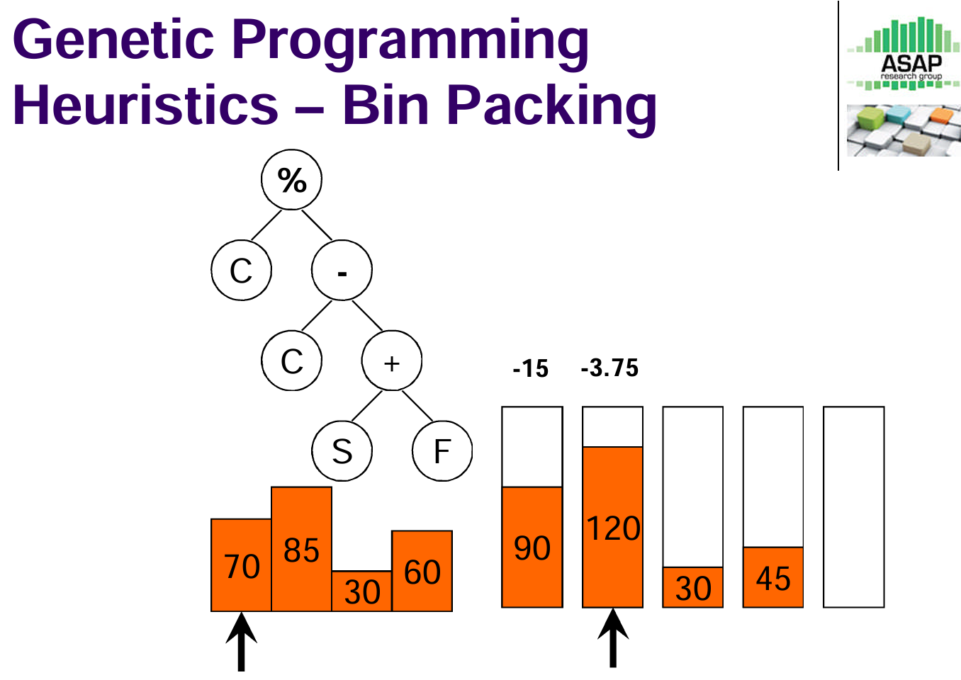
Case Study: GP Hyper-heuristic

Slide 25
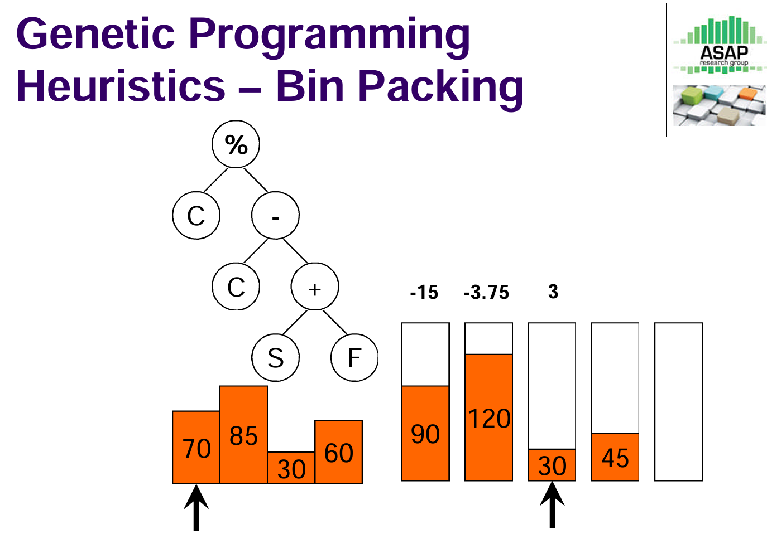
Case Study: GP Hyper-heuristic

Slide 26
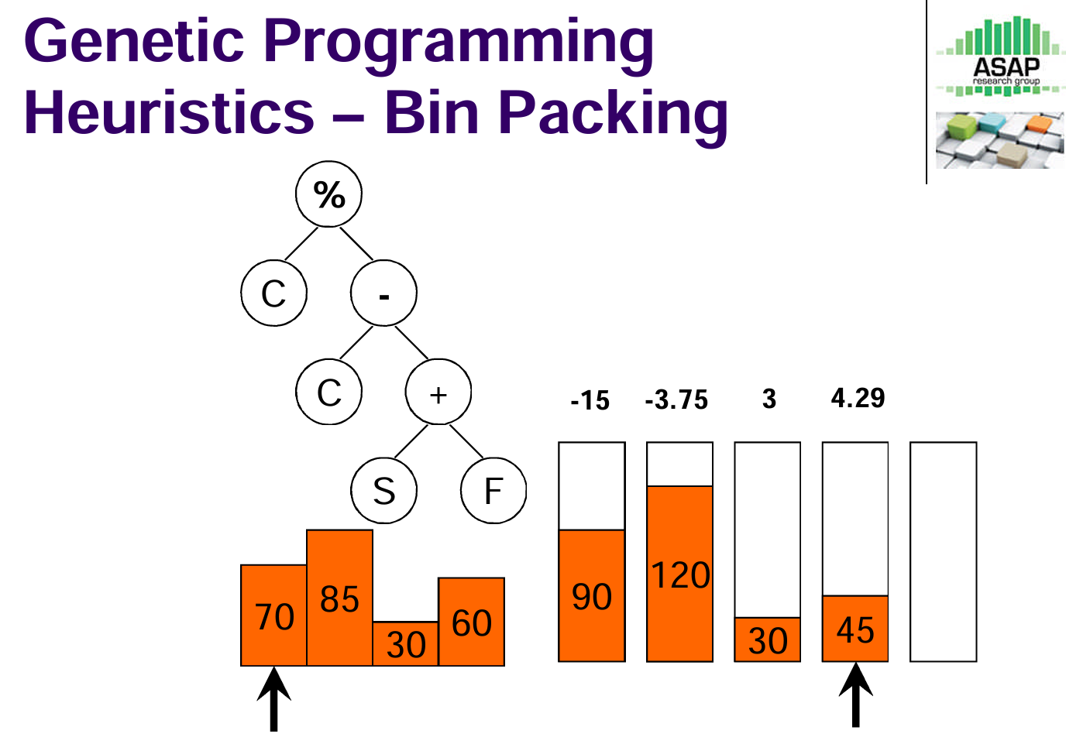
Case Study: GP Hyper-heuristic

Slide 27
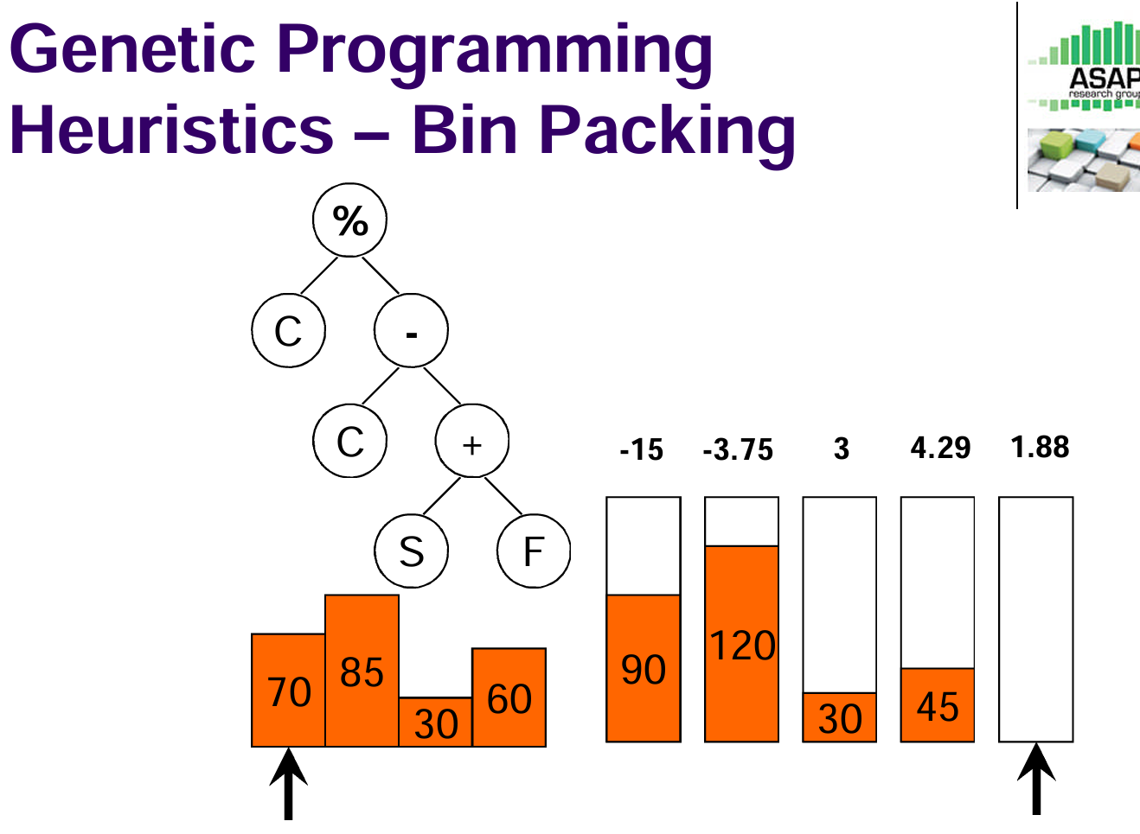
Case Study: GP Hyper-heuristic

Slide 28
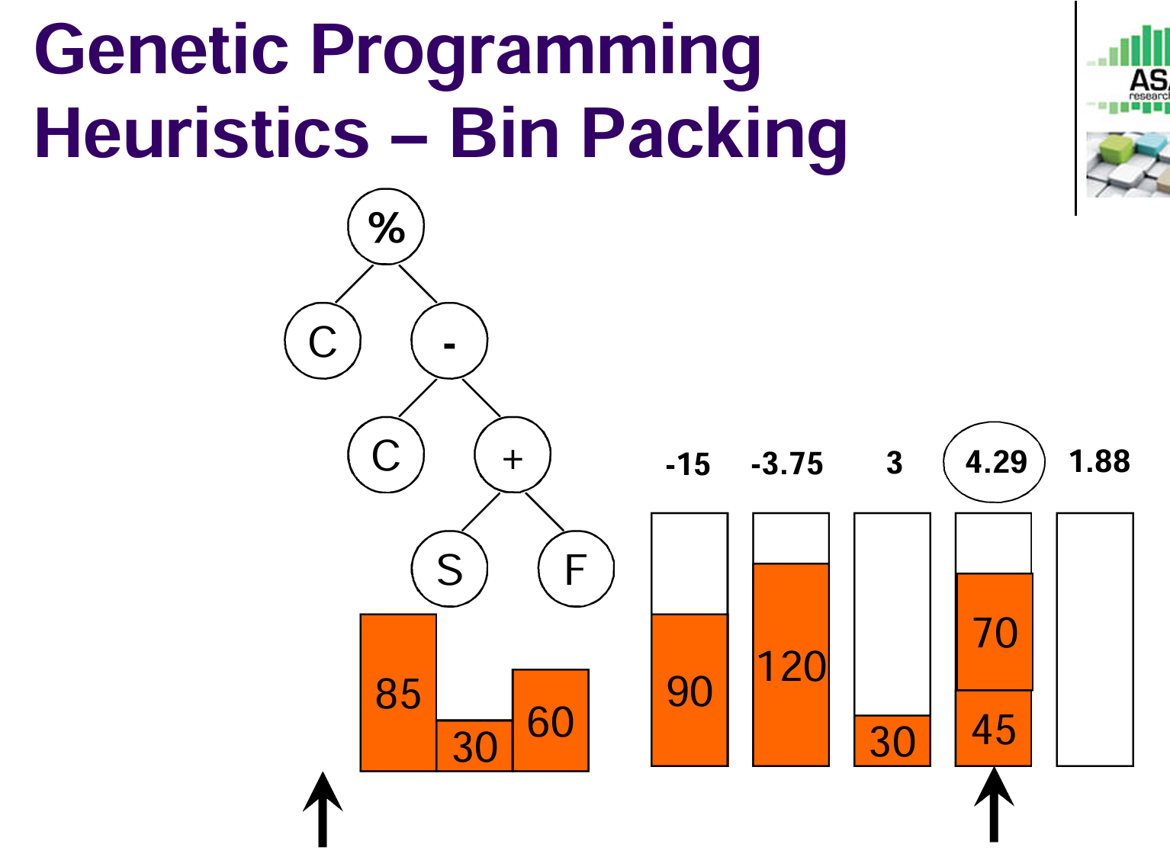
Case Study: GP Hyper-heuristic
选择最大的插入

Slide 29
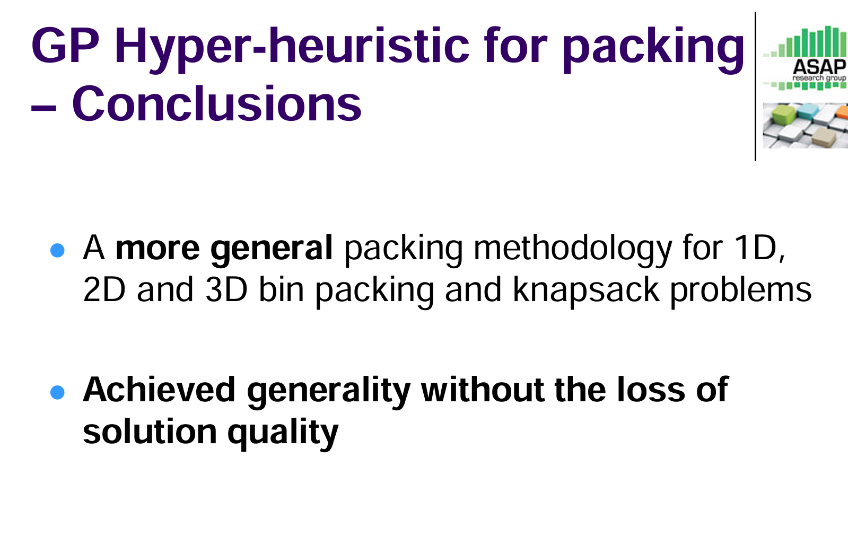
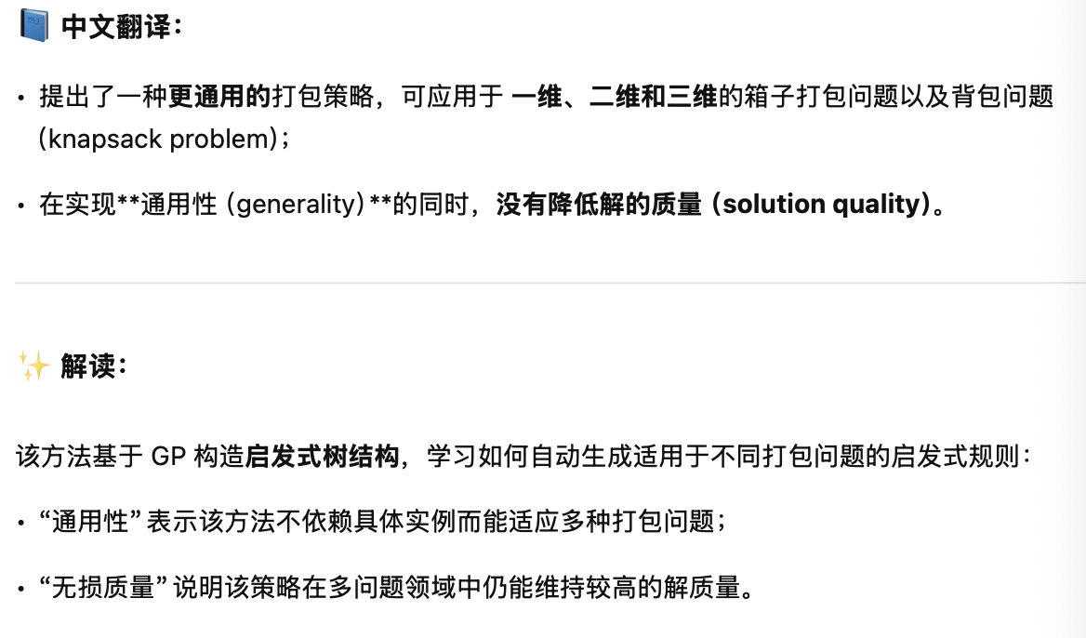
Case Study: GP Hyper-heuristic

Slide 30
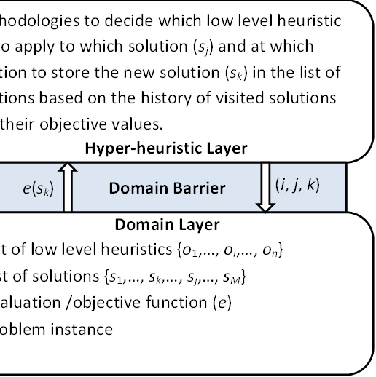
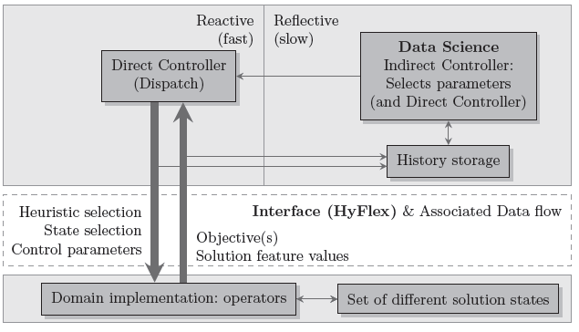
HyFlex
Hyflex was built in Nottingham ASAP group for a general framework for various hyper-heuristic algorithm development and testing
Current version 2.0.

Slide 31
Deep Reinforcement Learning Hyper-heuristics
Lu, H., Zhang, X., and Yang, S. (2020). A learning-based iterative method for solving vehicle routing problems. In ICLR.

Slide 32
Intesification
Diversification

Slide 33
Results

Slide 34
A Generation Hyper-heuristic Framework
Using machine learning methods to evolve (low-level) heuristics.
Often expressed in terms of trees/maps.
Genetic programming tree
State-action map
-
Bin Capacity
C
+
Piece Size
S
F
Bin Fullness

Slide 35
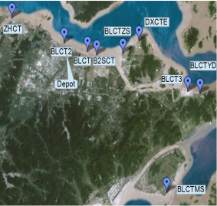
A real-life application
Ningbo Port is the 3rd largest in the world, almost 20m TEUs in 2015.
Important part of Ningbo Smart City project.
Ningbo Port is also a very import node in China’s One Belt One Road Programme.
World class hardware and relatively good IT systems.
Main issues: No integration, low hardware efficiency, low automation.

Slide 36
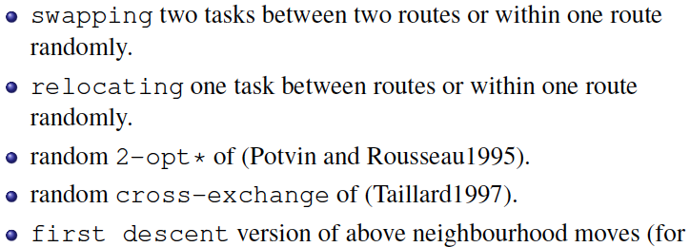
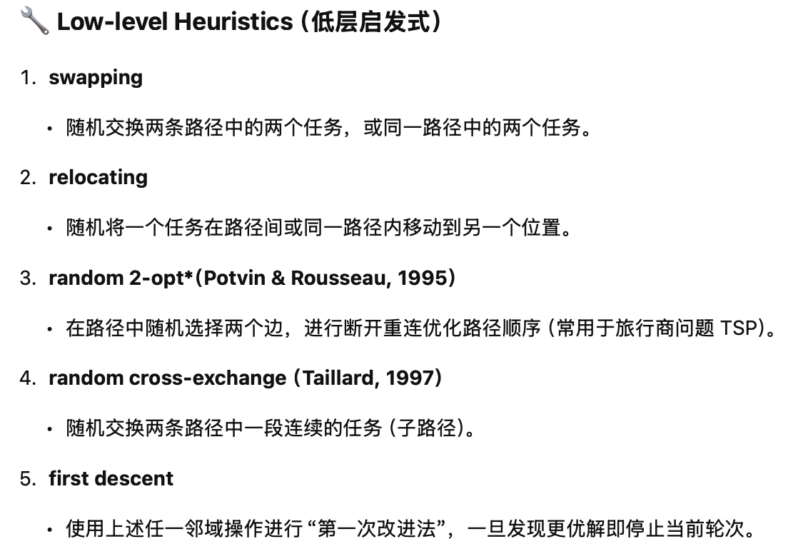
A Simulated Anneaing Hyper-heuristic
Low-level heuristics
.

Slide 37
Results 1

Slide 38
Results 2

Slide 39
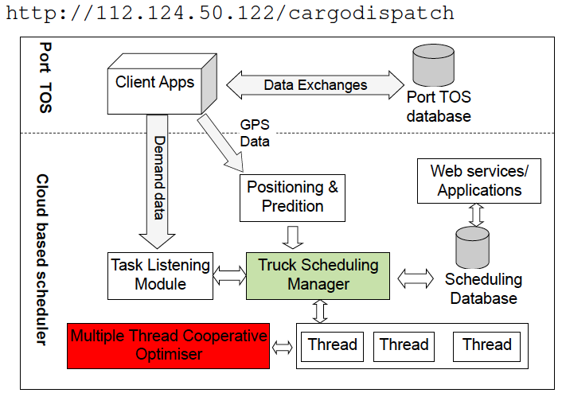
General results
10-15% improvement in performance

Slide 40
The next lecture
Multi-objective optimisation

